Slide 1
Accelerated Harris Corner Detector
Andrew Tu
Eece5640
Spring 2019

Slide 2
Corner Detectors
Corners make good features to track
Rotation Invariant
Translation Invariant
Useful for matching point between two images

Slide 3
Harris Corner Detector
Find large changes in intensity in BOTH x and y direction

Slide 4
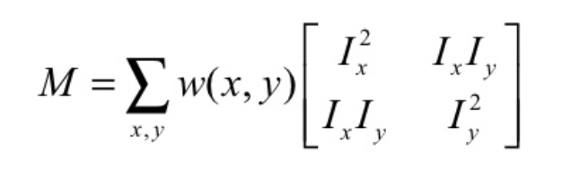
Harris Corner Detector
𝝺₁ = I_{x}²
𝝺₂ = I_{y}²

Slide 5
Harris Corner Detector

Slide 6
Harris Corner Detector Pipeline
find (dx)^2
find dx
Image
find xy
Calculate R
Threshold on R
find dy
find (dy)^2

Slide 7
Harris Corner Detector Pipeline
find (dx)^2
find dx
Image
find xy
Calculate R
Threshold on R
find dy
find (dy)^2
This is done FOR EACH PIXEL

Slide 8
Harris Corner Detector Pipeline
SIMD
Approved
find (dx)^2
find dx
Image
find xy
Calculate R
Threshold on R
find dy
find (dy)^2
This is done FOR EACH PIXEL

Slide 9
Project Goals
Implementation Goals
Analysis
Implement Harris Corner in C++
Accelerate with OpenMP
Accelerate with CUDA
Compare and explain timing results
Look into further CUDA Optimizations

Slide 10


Preliminary Image Results
C++ Implementation
OpenCV “Ground Truth”
(No Non-Max Supression or Gaussian Smoothing)

Slide 11
Preliminary Timing Results

Slide 12
Preliminary Timing Results
????

Slide 13
Naïve CUDA Implementation
Performs the entire pipeline except thresholding in a single memory transfer on the GPU
One thread per pixel (maximize throughput)
All data is read in and out of GPU Global Memory
Thresholding is done on the CPU (serially)
Does not perform gaussian smoothing or non-max supression

Slide 14
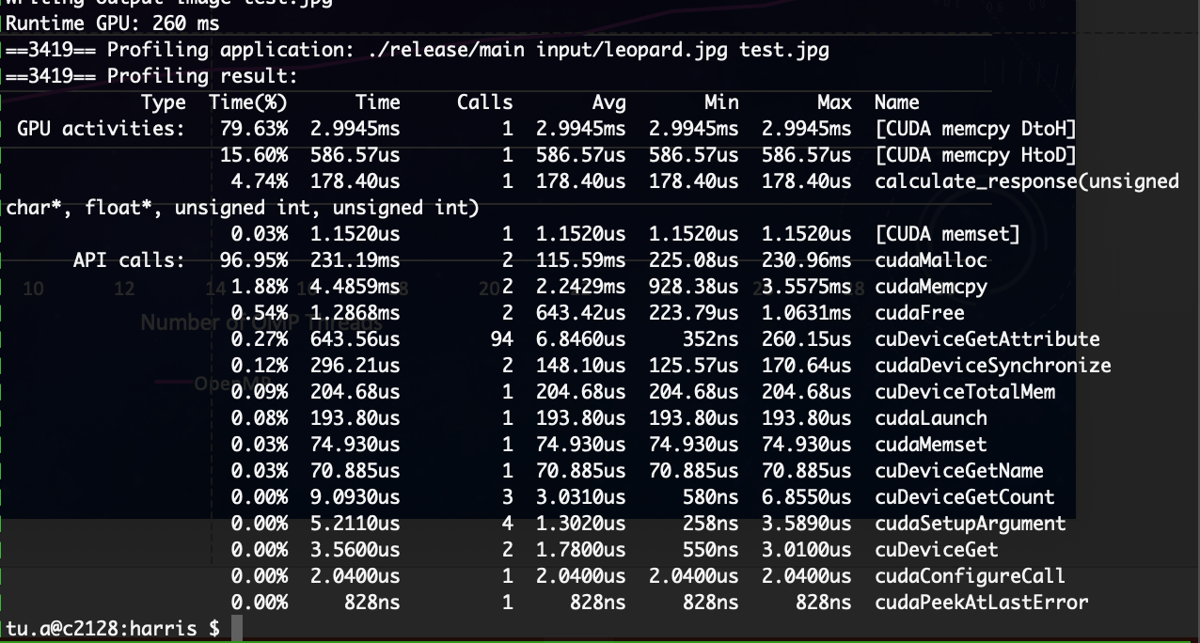
CUDA Timing Results

Slide 16
Actual Work Performed

Slide 17
Overhead Costs!

Slide 18
Future Work
Look at smarter ways of dividing up work on GPU
Explore slow down in OpenMP
Asynchronous transfers & convolutions
Use of Constant + Texture Memory
Expand Harris Corner Implementation for more robust execution

